Slide 1
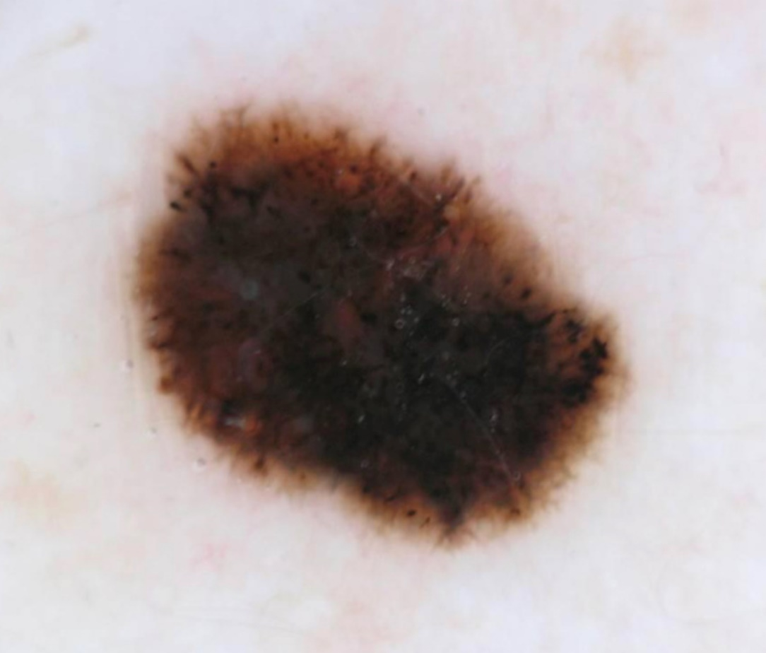

Tenth ISIC Skin Image Analysis Workshop @MICCAI 2025
Organizers:
M. Emre Celebi Catarina Barata Allan Halpern Philipp Tschandl Marc Combalia Yuan Liu Kumar Abhishek Joanna Jaworek-Korjakowska Moi Hoon Yap

Slide 2
ISIC Challenges & Workshops
Skin Lesion Analysis Towards Melanoma Detection/Skin Image Analysis
Organizers: Abhishek, Barata, Celebi, Codella, Combalia, Dana, Gutman, Halpern, Helba, Jaworek-Korjakowska, Kittler, Liu, Rotemberg, Tschandl, Yap, etc.
IEEE Int. Symp. on Biomedical Imaging (ISBI 2016, 2017)
Int. Conf. on Medical Image Computing & Computer Assisted Intervention (MICCAI 2018, 2019, 2020, 2023, 2024, 2025)
IEEE/CVF Conf. on Computer Vision & Pattern Recognition (CVPR 2019, 2020, 2021)
European Conference on Computer Vision (ECCV 2022)

Slide 3
Workshop Statistics
23 submissions received
6 submissions accepted (≈26%)
23 reviewers
≈3.69 reviews per submission

Slide 4
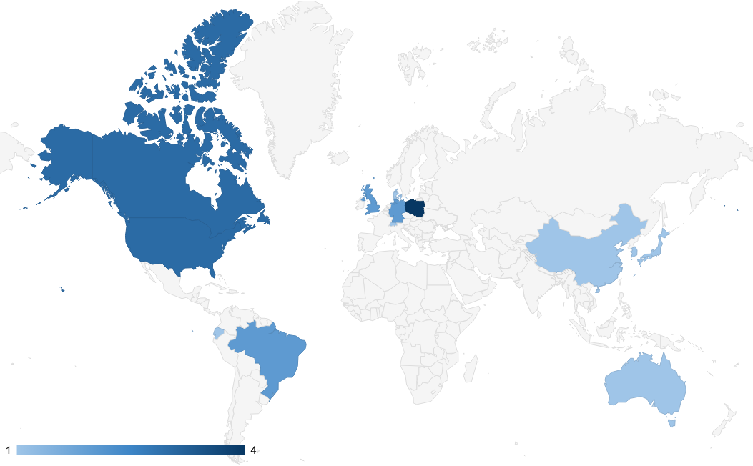
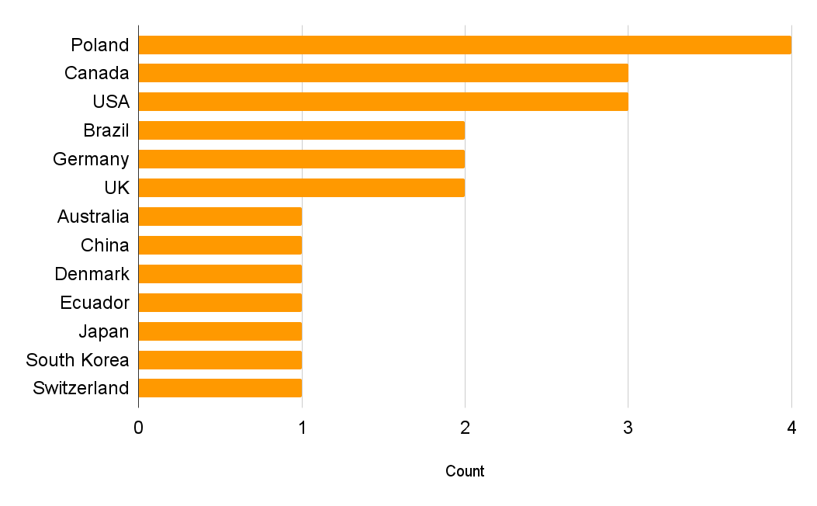
Workshop Statistics: Submitting Authors

Slide 5
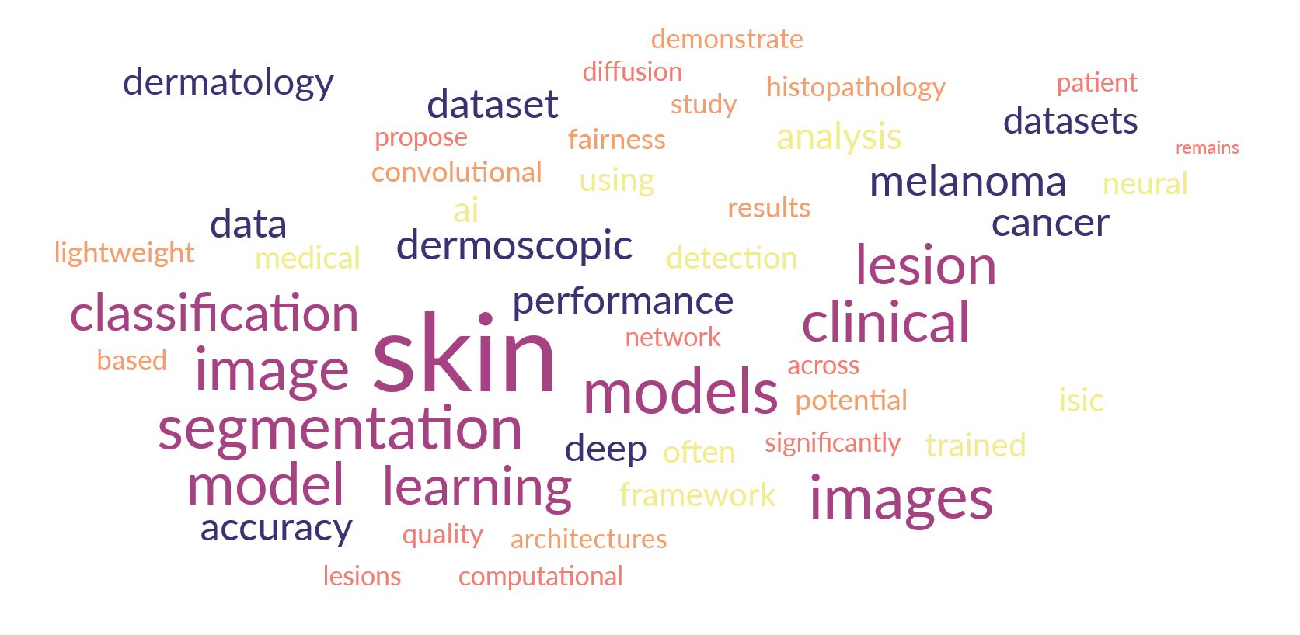
Workshop Statistics: Keywords

Slide 6
Workshop Program
Opening Rmks. (1:30−34) Inv. Talk 1 (1:34−2:10)
Oral Pres. 1 (2:10−34) Short Break 1 (2:34−42)
Oral Pres. 2 (2:42−3:06) Oral Pres. 3 (3:06−3:30)
Coffee Break (3:30−4:00) Inv. Talk 2 (4:00−36)
Oral Pres. 4 (4:36−5:00) Short Break 2 (5:00−08)
Oral Pres. 5 & 6 (5:08−56) Closing Rmks. (5:56−6:00)

